Slide 1


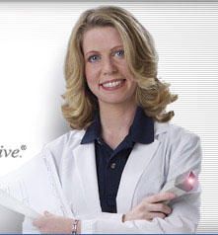
Dosage forms used for medications at anazaohealth
Christopher Lacey

Slide 2
objectives
To recognize, name, recall, and arrange various dosage forms of medications within the pharmacy.
To answer questions pertaining to drug use, mechanism of action, and drug distribution within the body for medications dispensed at AnazaoHealth.
To explain the special procedures associated with non-sterile compounding of various custom made products at AnazaoHealth.

Slide 3

PREVIEW
Introduction & Problem Statement
Different dosage forms confusion
Externally Applied Dosage Forms
Creams
Gels
Oral Dosage Forms
Rapid Dissolve Tablets
Sublingual Tablets
Capsules
Troche
Impact & Significance
Enhanced pharmacy workflow

Slide 4
Introduction & Problem Statement
Numerous Dosage Forms in the Custom Products Pharmacy
Confusion
Education is Necessary

Slide 5
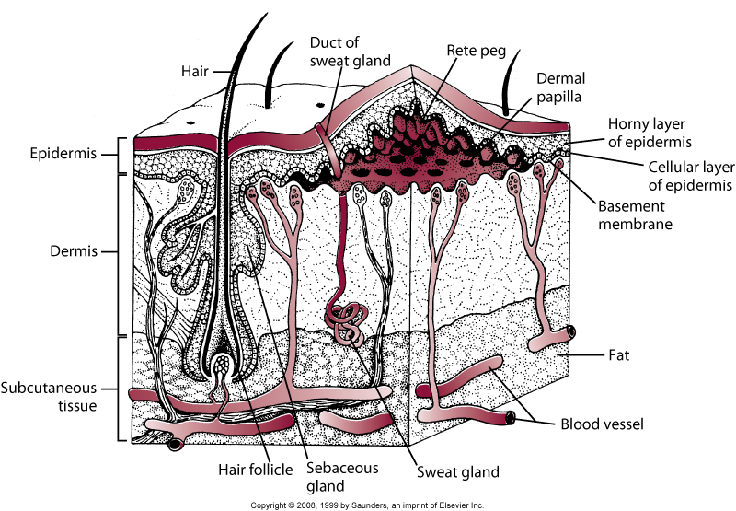
creams
Drug Permeation in the skin
Generally very slow
Transepidermal – through the epidermis
Transappendageal – through hair follicles, sweat glands, sebaceous glands
Patient preference
Creams are non-greasy & easy to apply
Creams face the problem of phase separation, hydrolytic degradation, and microbial growth

Slide 6
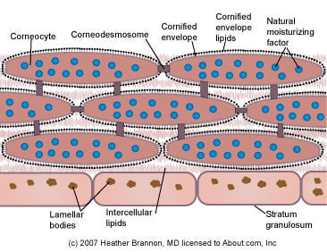
creams
Drug Permeation in the skin
Multibilayers composed of alternating lipid and water phases between corneocytes
Tortuous path through Stratum corneum
Small molecule that is very soluble in both lipids & water is ideal
Drug potency should be high as penetration is low
Notes:
Overall the Stratum corneum is a relatively lipophilic barrier; but balance is needed as a very lipophilic drug may have trouble passing through the skin as the SC presents as a hydrophilic barrier
Drugs can enter through the transcellular (through cells) or paracellular (between cells) route
Hydration of the skin generally enhances drug permeation through the skin because of its effect on the SC; occlusion of the skin blocks transepidermal water loss, leading to skin hydration at the site of occlusion

Slide 7
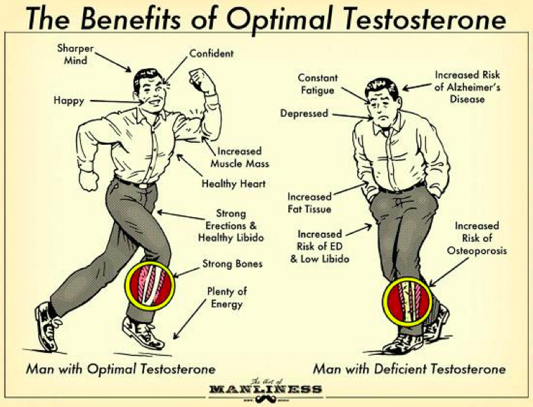
Testosterone cream
What is an example of a cream we make?
Testosterone
What is it for?
Increased muscle mass
Hypogonadism
Osteoporosis
Enhanced libido
Notes:
What Is It? This is a thyroid replacement hormone and is used to treat hypothyroidism (low thyroid). Your prescription is compounded into a special powdered base that is designed to slow the release of the drug after you swallow the capsule. This may allow for slower uptake of the product and more even blood levels
How to Use: Slow Release T3/T4 is commonly taken twice daily – every 12 hours, usually with food or milk. It may take a few weeks to recognize the full action of this compound.

Slide 8
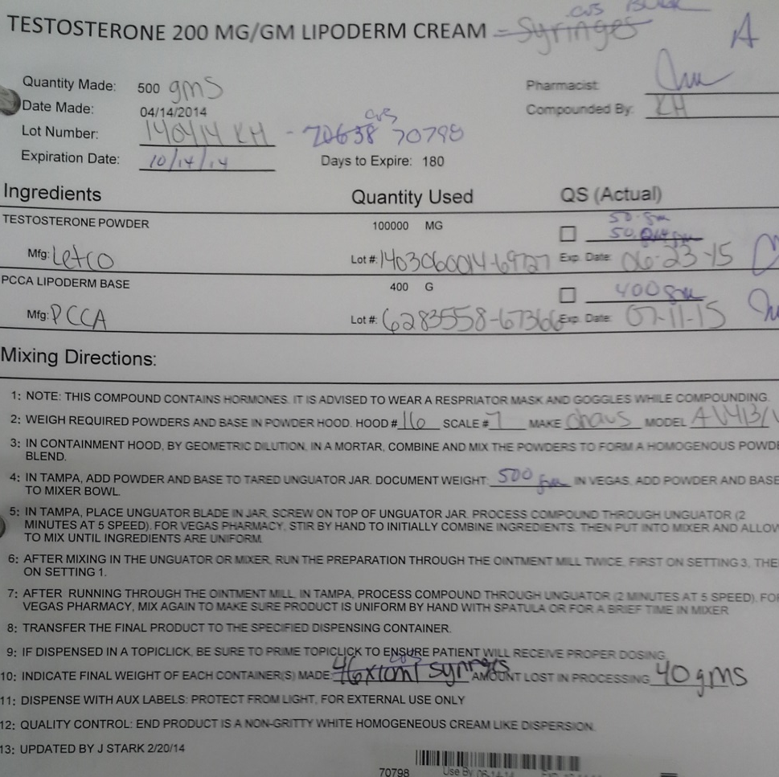
Testosterone compounding
How is it compounded?
Add powder and base to tared unguator jar and run unguator
After mixing, run cream through the ointment mill twice (setting 3 first, then 1)
Notes:
What Is It? This is a thyroid replacement hormone and is used to treat hypothyroidism (low thyroid). Your prescription is compounded into a special powdered base that is designed to slow the release of the drug after you swallow the capsule. This may allow for slower uptake of the product and more even blood levels
How to Use: Slow Release T3/T4 is commonly taken twice daily – every 12 hours, usually with food or milk. It may take a few weeks to recognize the full action of this compound.

Slide 9
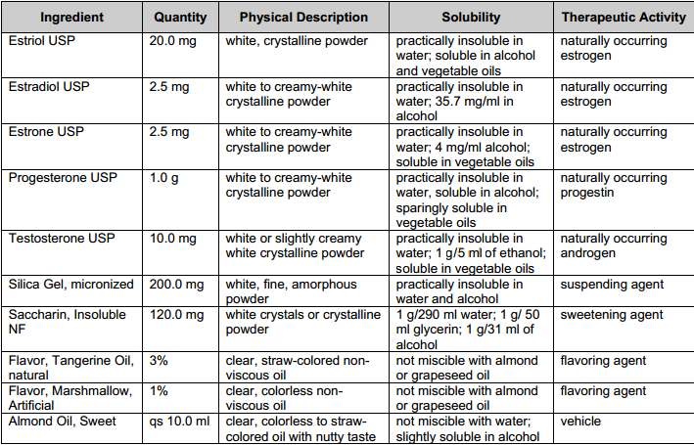
Drug physical property chart
http://pharmlabs.unc.edu/labs/formulation_records/estrogen_subling_drops_form.pdf

Slide 10
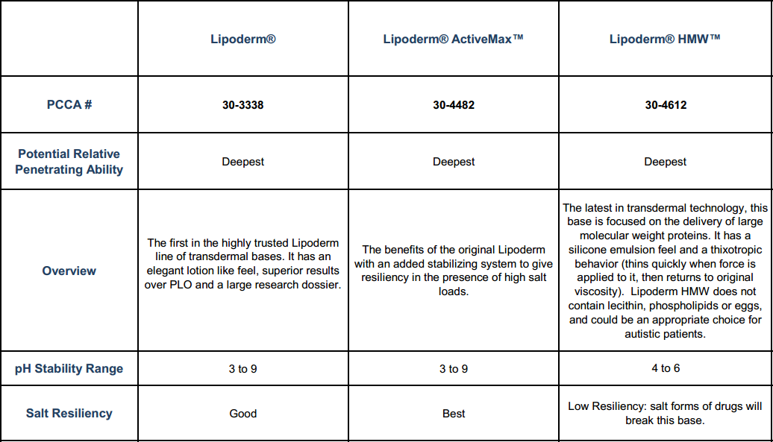
Pcca transdermal Bases
file:///C:/Users/Chris/Desktop/Rotations/Anazao%20Health/94008_TransdermalBaseChart.pdf

Slide 11
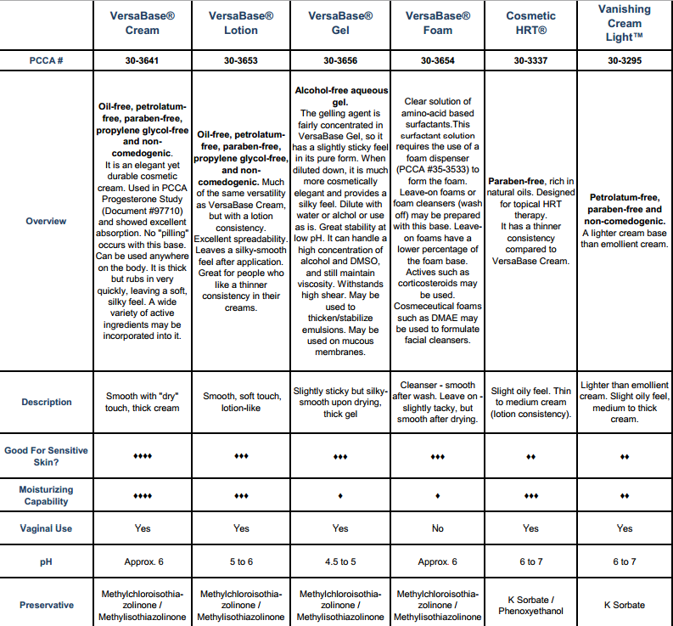
Pcca transdermal Bases
file:///C:/Users/Chris/Desktop/Rotations/Anazao%20Health/94008_TransdermalBaseChart.pdf

Slide 12
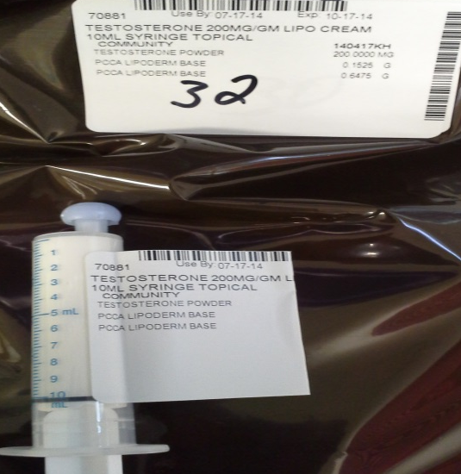
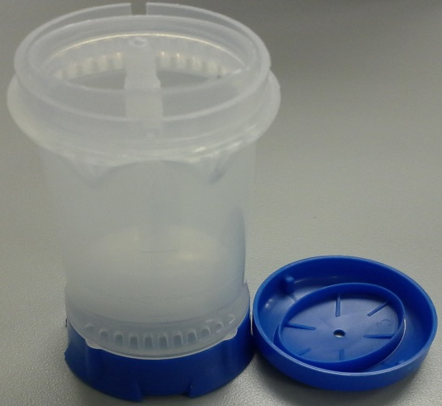
cream Medication list
Creams
Pain Creams
Baclofen/cyclo/diclo/ tetracaine
BLT Anesthetic
Benzocaine/lidocaine/ tetracaine
Ketoprofen/Bupivacaine/ Gabapentin/Lipoderm
Meloxicam/Topiramate/ Lidocaine/Tramadol
Hormone creams
Testosterone
Progesterone
Biest
Notes:
What best describes the ideal physicochemical properties of a molecule designed to permeate or pass easily through skin?
A small molecule that is very soluble in both lipids and water
What is the major barrier to flux through the skin?
The multibilayers composed of alternating lipid and water phases between the corneocytes in the stratum corneum

Slide 13
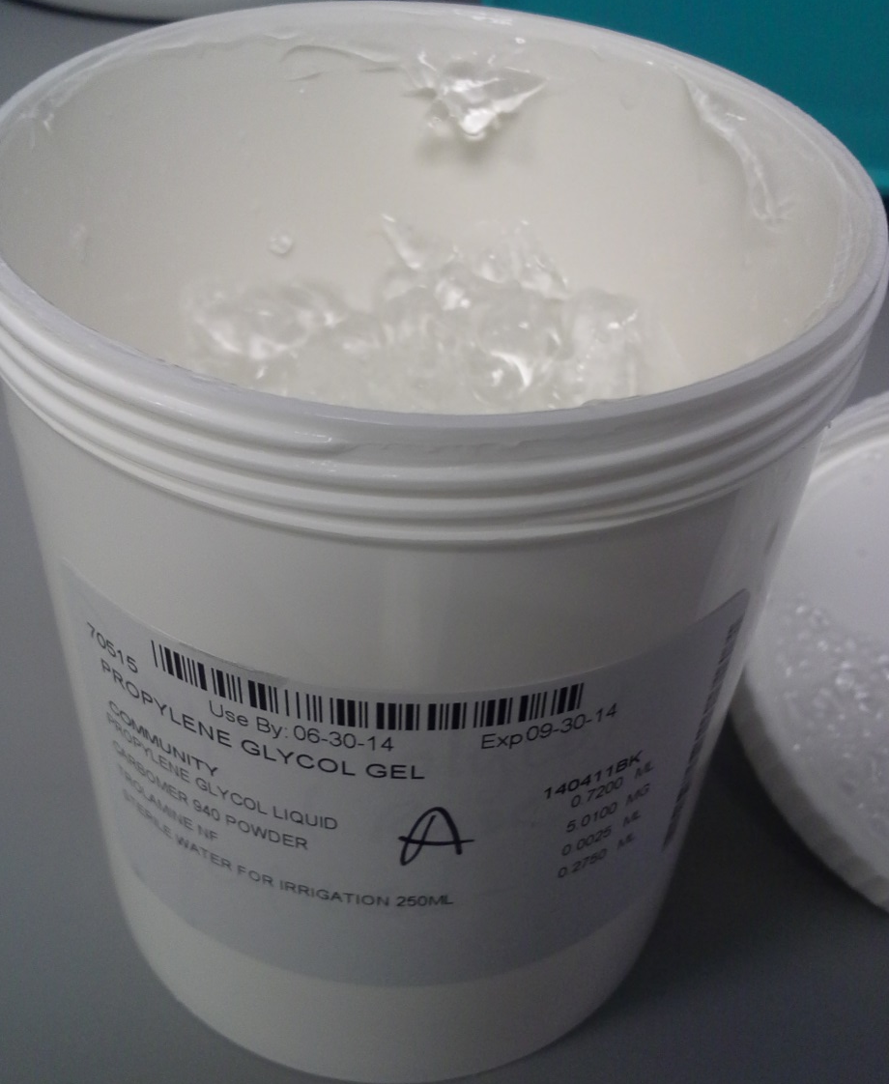
gels
Properties of Gels
“Semisolid systems in which a liquid phase is constrained within an interlocked, polymeric matrix of a natural or synthetic gum”
Synthetic gum = polysaccharide
Dispersions of molecules in a liquid vehicle rendered jelly-like through the addition of a gelling agent
Gelling is achieved by a high degree of physical or chemical crosslinking
Carbomers, cellulose derivatives

Slide 14
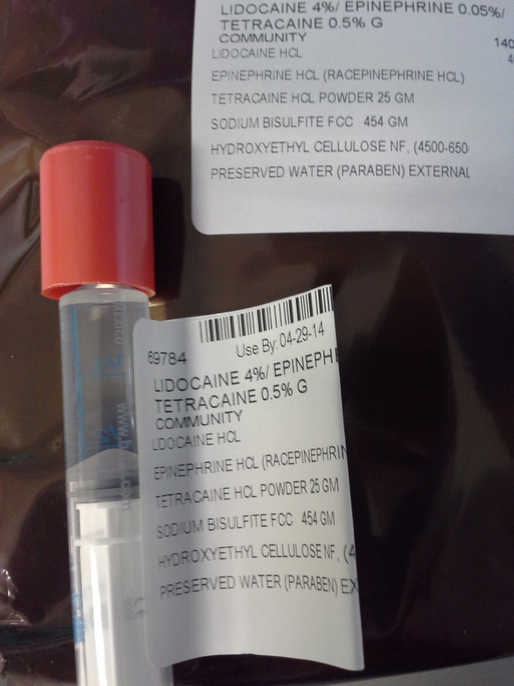
gels
Properties of Gels
Upon application, the solvent evaporates, leaving a porous matrix for the drug to diffuse through
The evaporation of the solvent cools and soothes
Most are water-washable and greaseless
Can have a drying effect if alcohol content is high in the liquid phase

Slide 15
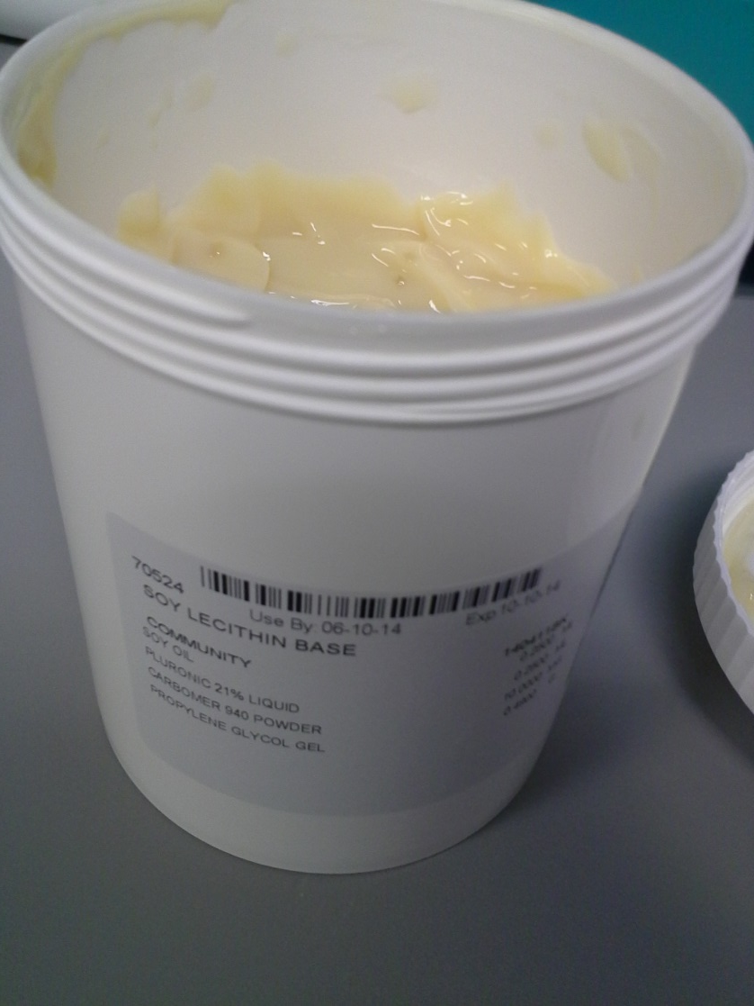
Gel Bases
Propylene Glycol
Prevents precipitation of drug as the gel dries to a thin film
Less volatile than water
Remains behind as water evaporates keeping drug in solution
Soy Lecithin
Complex mixture of phospholipids, glycolipids, triglycerides, sterols, and small quantities of fatty acids, carbohydrates and sphingolipids
Notes:
Primary components:
Phosphatidylcholine (PC) (13%-18%) Phosphatidylethanolamine (PE) (10%-15%) Phosphatidylinositol (PI) (10%-15%) Phosphatidic acid (PA) (5%-12%)

Slide 16
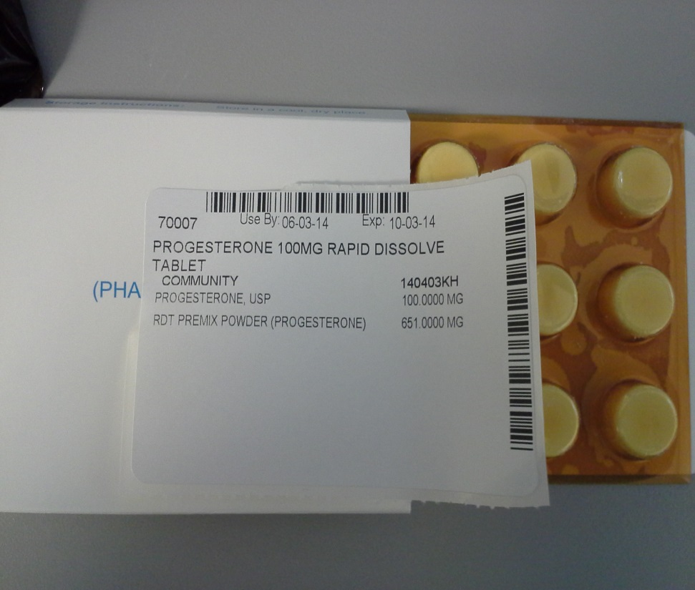
Rapid dissolve tablets
Properties of RDT
Typically dissolves in mouth < 1 min
Possibly faster onset of action because of disintegration
Base, PCCA Rapid Dissolve Tablet Powder
Tablets are baked in oven at 105° C for 30 min
Don’t allow temperature to exceed 110° C or may degrade active ingredient
Leaves a very porous product
Absorb water quickly
Ingredients:
Sucrose, Mannitol, PEG-75, Citric Acid, Sodium Bicarbonte

Slide 17
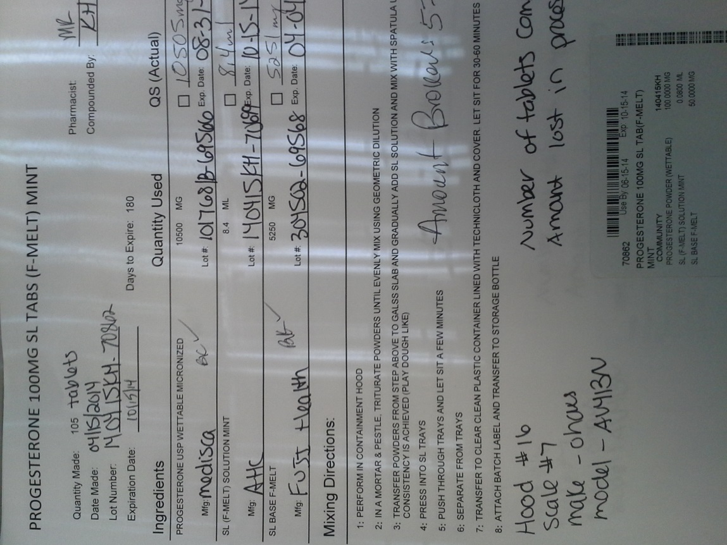
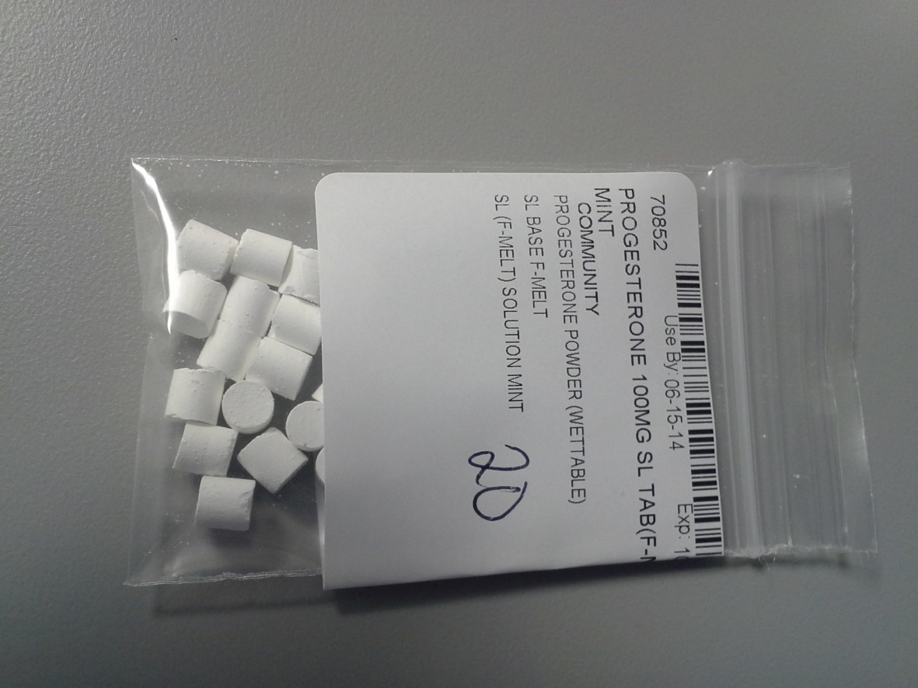
Sublingual tablets
Notes:
Disease state prevalence - CDC
Cost statistic - Journal of Allergy and Clinical Immunology

Slide 18
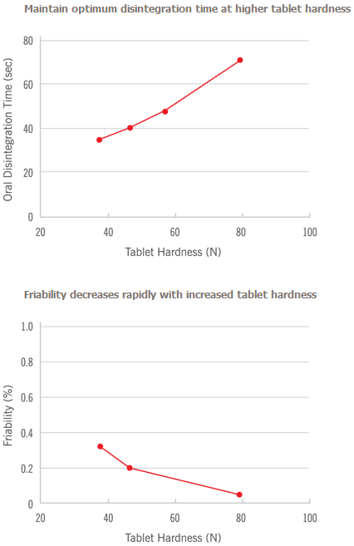
Sublingual tablets
Features of F-Melt, F1
Cospray-dried powder
Combines inorganic excipients and disintegrants dispersed in a carbohydrate complex
Directly compressible
Disintegrating time less than 30 sec
API loading > 50% possible
Highly flowable with minimum or no sticking / capping
http://www.f-melt.com/product/general_properties.php#performance
Notes:
National Asthma Education and Prevention Program (NAEPP), 2007 doesn’t recommend this drug for routine management of asthma patients

Slide 19
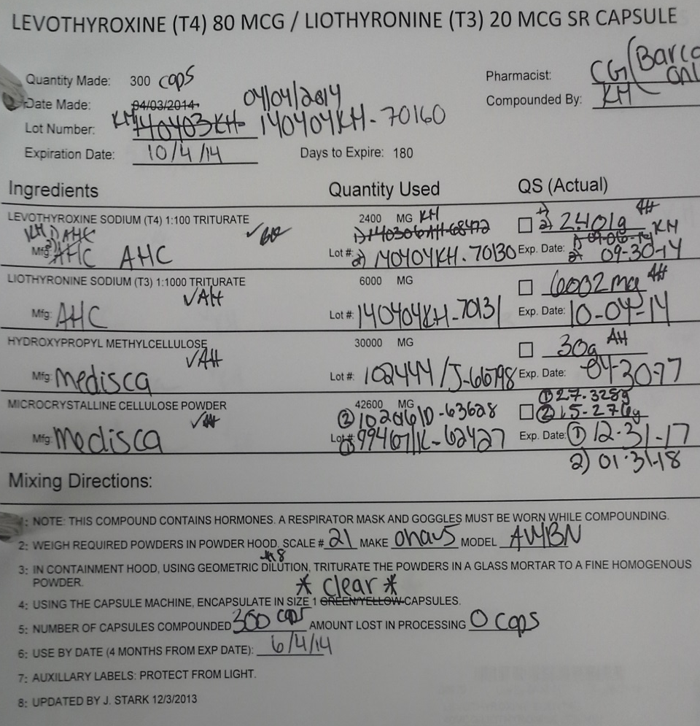
Capsules SR
Rate-controlled Dosage Forms
Sustained-release systems are those that allow at least a two-fold reduction in dosing frequency compared to that of the same drug in a conventional dosage form

Slide 20
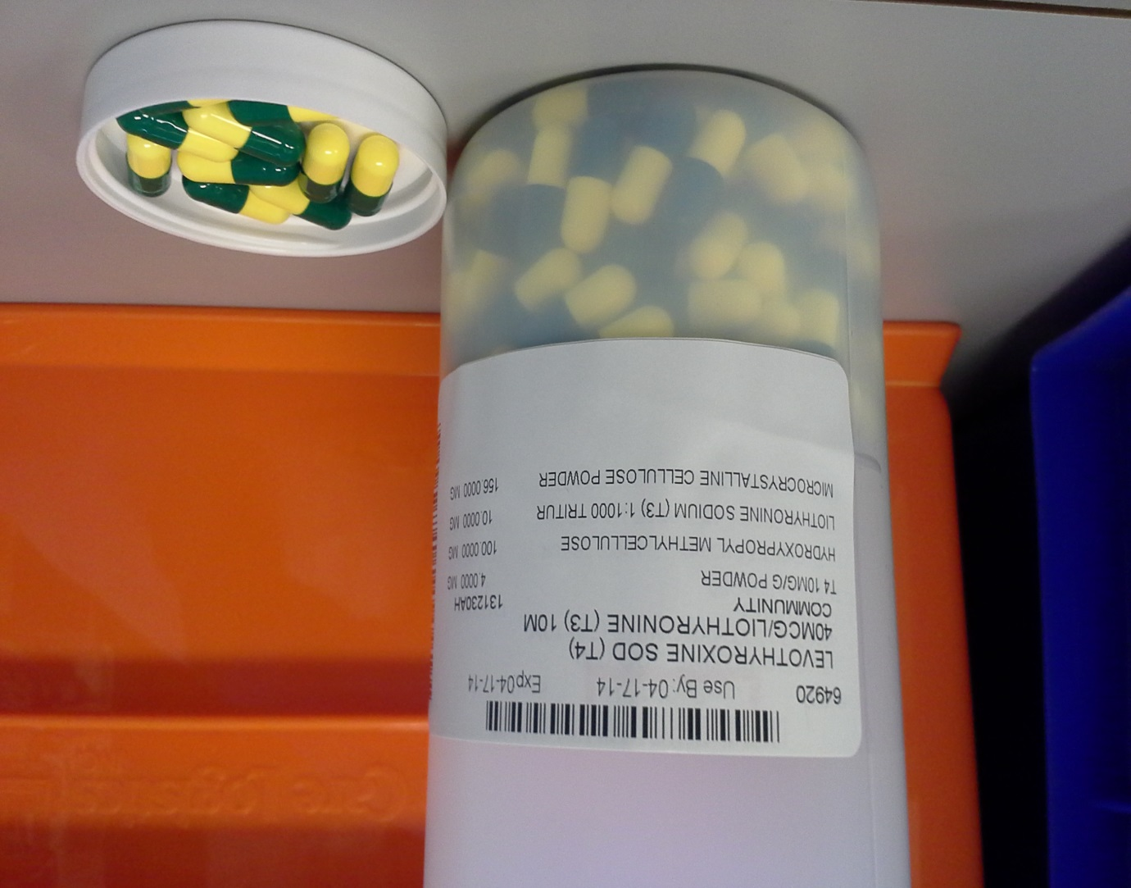
Capsules SR
What are some examples?
Slow Release T3/T4
What is it for?
Thyroid replacement hormone used to treat hypothyroidism (low thyroid)
How is it compounded?
Compounded into a special powdered base that is designed to slow the release of the drug after swallowing
Dosing regimen?
Commonly taken BID
Notes:
What Is It? This is a thyroid replacement hormone and is used to treat hypothyroidism (low thyroid). Your prescription is compounded into a special powdered base that is designed to slow the release of the drug after you swallow the capsule. This may allow for slower uptake of the product and more even blood levels
How to Use: Slow Release T3/T4 is commonly taken twice daily – every 12 hours, usually with food or milk. It may take a few weeks to recognize the full action of this compound.

Slide 21
Capsules SR Absorption
Hydroxypropyl methylcellulose (HPMC)
Polymer used as an emulsifier, thickening and suspending agent
Hydrophilic excipient
In water, swells and produces a viscous colloidal suspension
Delays settling and increases drug contact time within the GI tract
Notes:
An excipient is an inactive substance formulated alongside the active ingredient of a medication, for the purpose of bulking-up formulations that contain potent active ingredients
An emulsifier (also known as an "emulgent") is a substance that stabilizes an emulsion by increasing its kinetic stability. One class of emulsifiers is known as "surface active agents", or surfactants; Ex. Include soy lecithin
Thickening agents, or thickeners, is the term applied to substances which increase the viscosity of a solution or liquid/solid mixture without substantially modifying its other properties;

Slide 22
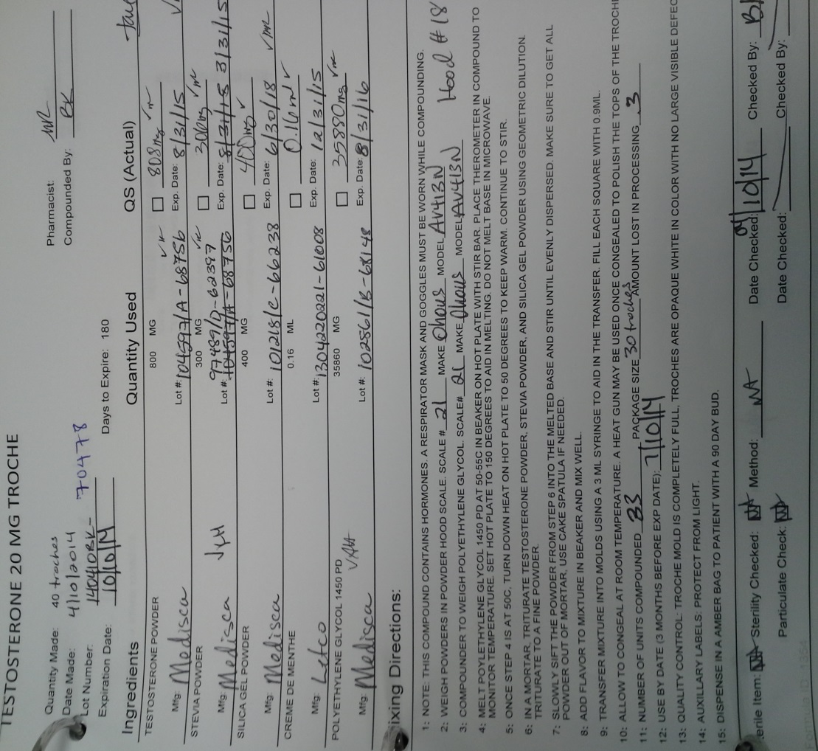
troches
Compounding
Made from 2 different bases:
Polyethylene glycol (PEG) – hard troche
Can cause gum inflammation
Not recommended for patients with chemical sensitivties
Gelatin – soft troche
Hydrophilic base that causes hydrophobic particles to aggregate together
Particle aggregation may reduce absorption
Notes:
National Asthma Education and Prevention Program (NAEPP), 2007 doesn’t recommend this drug for routine management of asthma patients

Slide 23
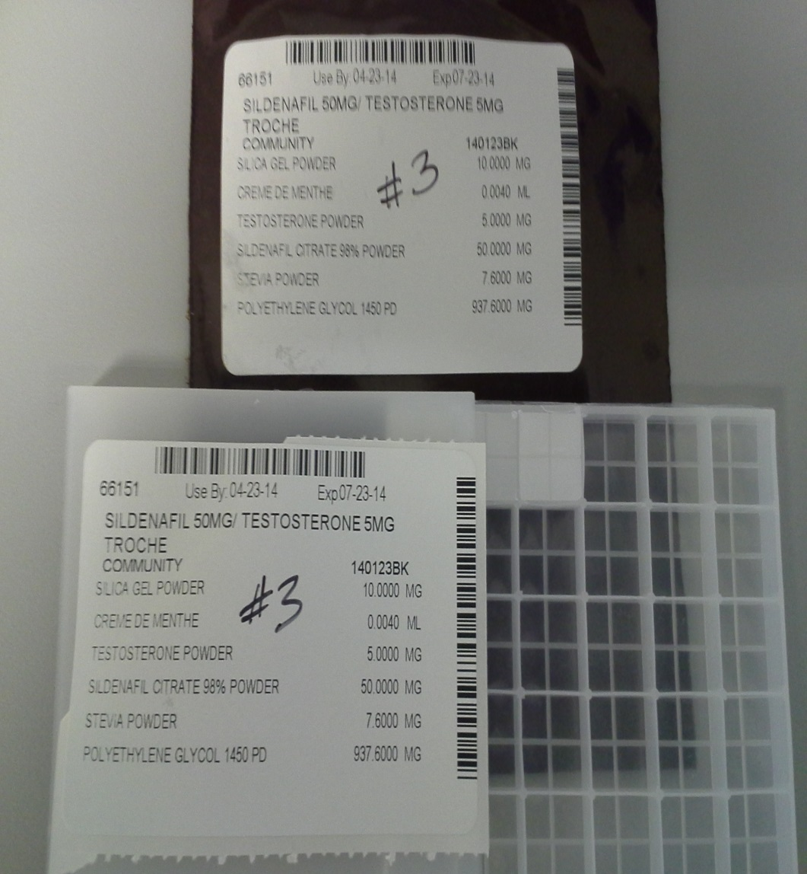
troches
Pharmacokinetics
Hormone levels rise rapidly and fall rapidly within 4-5 hr
Requires BID dosing & up to QID
Up to 70% of dose is actually swallowed by the normal salivation process
Hormones that possess poor oral bioavailability such as progesterone and testosterone (10-15%) are good candidates for this route
Notes:
Disease state prevalence - CDC
Cost statistic - Journal of Allergy and Clinical Immunology

Slide 24
summary
Introduction & Problem Statement
Different dosage forms confusion
Externally Applied Dosage Forms
Creams
Gels
Oral Dosage Forms
Rapid Dissolve Tablets
Sublingual Tablets
Capsules
Troche
Sublingual Troche
Impact & Significance
Enhanced pharmacy workflow

Slide 25
Future student presentations
Externally Applied Dosage Forms
Cream and gel base selection
Compounding alternatives
Ex. Progesterone RDT’s

Slide 26
Resources
Kamin W., Schwabe A., Kramer I., “Which one are allowed to be mixed? Physico-chmical compatiblity of drug solutions in nebulizers.” Journal of Cystic Fibrosis 5 (2006) 205-213.
McLaughlin R., Banbury, S., Crowley K.,“Orally Disintegrating Tablets – The Effect of Recent FDA Guidance on ODT Technologies and Applications.” Pharmaceutical Technology 2009. Available: file:///C:/Users/Chris/Downloads/wp_FDA%20guidance%20on%20ODTs.pdf. Accessed April 23, 2014.
Parkash V., Maan S., “Fast disintegrating tablets: Opportunity in drug delivery system.” J Adv Pharm Technol Res. 2011 Oct-Dec; 2(4): 223-235. Available: http://www.ncbi.nlm.nih.gov/pmc/articles/PMC3255350/. Accessed April 23, 2014.
PCCA. “Lipoderm.” PCCA Inc. Available: http://www.pccarx.com/pcca-products/pcca-exclusives/bases/lipoderm. Accessed April 23, 2014.
Dave RH. Overview of pharmaceutical excipients used in tablets and capsules. Drug Topics (online). Advanstar. 10/24/2008 http://drugtopics.modernmedicine.com/drugtopics/Top+News/Overview-of-pharmaceutical-excipients-used-in-tabl/ArticleStandard/Article/detail/561047. Accessed 04/22/2014
Haider A., et. Al., “Progressive Improvement of T-Scores in Men with Osteoporosis and Subnormal Serum Testosterone Levels upon Treatment with Testosterone over Six Years.” Int J Endocrinol. 2014; 2014:496948. Available: http://www.ncbi.nlm.nih.gov.lp.hscl.ufl.edu/pubmed/24688541. Accessed April 23, 2014.

